Slide 1


TITLE OF THE MINI-PROJECT 2D PLOTTER CNC MACHINE
SREYAS INSTITUTE OF ENGINEERING & TECHNOLOGY
(Approved by A.I.C.T.E.New Delhi., Affiliated to JNTUH Hyderabad, Accredited by NAAC & NBA)
DEPARTMENT OF ELECTRONICS & COMMUNICATION ENGINEERING
Under the Guidance of S.Subrahmanyam
Assistant Professor
Presented by
Kaasoju Sai Teja (18VE1A04E1)
A. Anirudh Reddy (18VE1A04C2)
Sai Kruthi Kanakuntla (18VE1A04G7)

Slide 2
Abstract
This project shows how to design and building low cost Arduino plotter machine based on the open source hardware and software. The Arduino plotter machine has been dependent on the principle of Computer Numerical Control with limited area depends on the motion X, Y and Z axes. The objectives of this project are to design the Plotter and to develop open source software for control the machine. Basically, the system of this plotter machine is modeling by solid work software to work with three axes stepper motors (as X, Y and Z axes), these three stepper motors are
Controlled by shield for movement (X, Y and Z axes). This machine’s movement onthe X axis is 40mm and Y axis is 40mm. Length of travel means the linear movement of stepper motors that control for X, Y and Z axes from point to another point. The left and right movement controlled by X axis stepper motor, front-back movement controlled by Y axis stepper motor and the pen is up-down that is controlled by Z axis stepper motor.

Slide 3
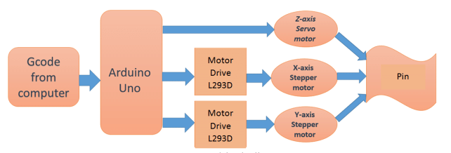
Block Diagram

Slide 4
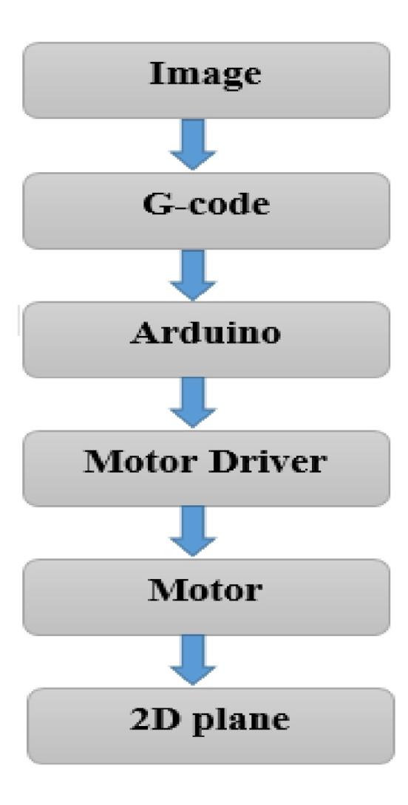
Flow Chart

Slide 5
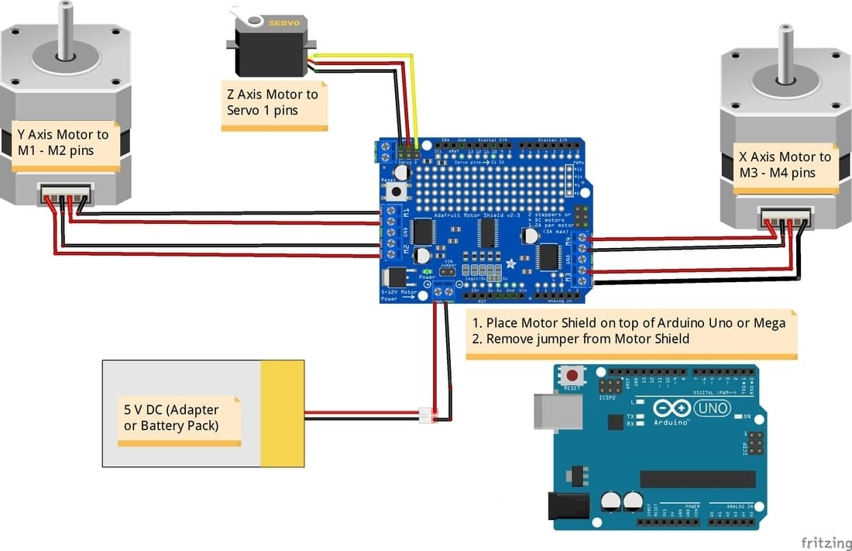
Schematic Diagram

Slide 6
Specifications of the Components
Arduino Uno
Arduino Uno is a microcontroller based on the ATmega328P Atmel AVR family microcontroller (MCU). It is an open source software and hardware design and manufacture of a single microcontroller. It has 14 digital Input/output pins and 6 Analogue input can be sampled using on-chip ADC. By using open source programming Arduino Uno. It also has 6 PWM outputs multiplexed onto the digital IO pins.
Servo Motor
A Servo Motor is a small device that has an output shaft. This shaft can be positioned to specific angular positions by sending the servo a coded signal. As long as the coded signal exists on the input line, the servo will maintain the angular position of the shaft. If the coded signal changes, the angular position of the shaft changes.
L293D Motor Driver
In computer numeric control Arduino Uno microcontroller and L293D motor driver are used which are capable of processing logical instruction interfaces with computers.
DVD Drivers
For the X and Y axes we will use two stepper motors and rails from the DVD drivers.

Slide 7
Simulation Results
The plotter has 3 degrees of freedom. The pen can move up and down in the Z axis and the pen is free to move along the 2D plane (X-Y axis). The pen is gripped by a servo motor for upward and downward movement. The setup has a base to enclose the circuitry. Above the base mechanism to move the plotter in the X and Y direction and ahead , the pen is assembled on the base. Two bi-directional motors are used in which one motor is used for the X axis and another for Y axis.
The coordinates are uploaded to the machine controller by a separate program. The image file is transformed into a G-code via software. Then the code is transferred to the microcontroller by which the motor mechanism is instructed to draw an image. In this paper, we are going to present a simple design for a 2D plotter. Our idea is an Arduino based on the Arduino Uno and L293D motor driver. The machine will have three motors to implement the X, Y and Z axis. A servo motor will be used along the Z axis for positioning the pen which will go up for logic ‘0’ and down for logic ‘1’ . Drawing will be done on the X-Y plane where the positioning will be controlled by stepper motors. System. The X axis is attached to two plastic parts and was cut to fit the construction. Ensure to put the Y axis straight to the 2D plotter base and the X axis vertically in this. On that surface the servo motor (Z axis) will be attached to the pen base. Pen must be able to move up and down with the aid of a servo motor. Now it will have to attach a hard surface on the Y axis. On this, it will put the paper piece to print the text or image that we programmed. The area of printing is 4cm x 4cm.

Slide 8
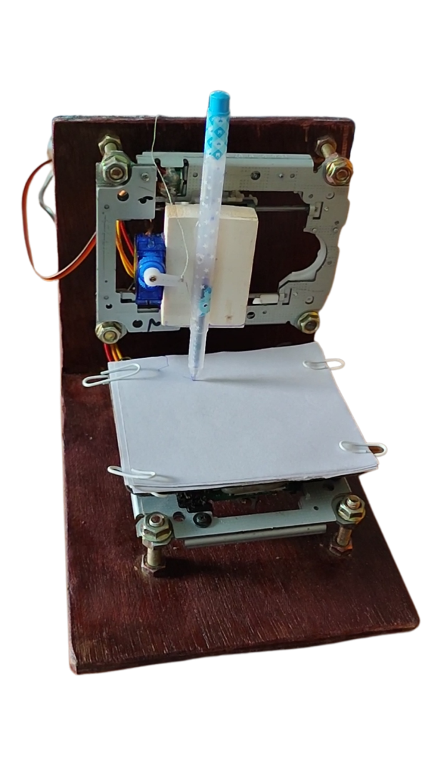
Hardware Pictures during Simulation

Slide 9
Conclusion
The pen holder is mounted on the CNC machine. The plotter movement in the X and Y direction is controlled using motor-coupled gear to move the position left and right and forwards and backwards. We use two L293D motor driver ICs to control the DC motor. The overall assembly of the X-Y plotter fabrication is by using DVD drives. This CNC machine is used to fabricate PCB.
The use of Inkscape as the G-code generator enables the users to draw and trace their image before converting it into a G-code file. The file is then attached to processing software, run in the Java language.
The processing language enables the user to specify the speed of the stepper, setting the (0, 0) location, go home setting, and to abandon plotting. The command is sent automatically after the G-code is loaded. The figure shows the original image and its 2D plotted image by the CNC plotter.

Slide 10
Advantages & Applications
Advantages
Cheap: Cheapest XY Plotter available in the current market
Mass Production: This model was not made in the most popular and conventional way in which the motion along the X-axis & Y-axis is provided by recycled CD drives of Old computers. Two stepper motors were used to provide motion along the X-axis & Y-axis. It is comprehendible that mass production of this product cannot be done through recycling process of CD drives. So, this model is suitable for mass production and marketing at a cheap rate.
Improved Mechanical Properties: The model is light weight as plastic wood was used to build the structure. Plastic wood is also Water resistive, so there are less likely to get affected by corrosion or rusting.
Portable: Due to it’s easy-to-carry structure and being lightweight, the setup is easily portable. Precision .

Slide 11
Advantages & Applications
Applications
Aerospace
Nearly every industry requires accuracy, but it is very crucial that airplane parts like turbine engines are built and operate at high accuracy levels. Aircraft cannot be considered safe or reliable for both goods and humans for travel purposes without exact parts.
Automotive
CNC machining is used in gears, pins, brakes, shafts, and other parts which are used on various types of vehicles of various models and sizes. From military cars to specialized auto vehicles, CNC machines play a major role in the production of both small and large parts.
Milling
With CNC machines, you can mill all materials. Different variants like synchronized milling and standard milling are used.
Cutting
You can also use a CNC machine as a cutting machine or as a plotter. There are many possible applications in this respect; the choice of the tool entirely depends on the material to be processed. CNC cutters are usually used to describe logos or lettering and cut them out of foil perfectly.

Slide 12
Future Scope
Same Mechanism can be used for 3D printing by adding Z-axis mechanism.
Drilling, PCB making, Laser engraving can be done with this model by changing the pen holder component.

Slide 13
References
Vitale G, A Bonarini, M Matteucci, and L Bascetta 2016 Toward Vocational Robotics: n Experience in Post-Secondary School Education and Job Training Through Robotics. IEEE Robotics and Automation Magazine. 23 73-81.
Sadanand R O M, R G Chittawadigi, R Joshi, and S K Saha 2015 Virtual Robots Module : An effective visualization tool for Robotics Toolbox. 2nd International Conference on Advances in Robotics (AiR-2015).
Sadanand R O M, S Sairaman, S P H B., G Udhayakumar, R G Chittawadigi, and S K Saha 2015 Kinematic Analysis of MTAB Robots and its integration with RoboAnalyzer software. 2nd International Conference on Advances in Robotics (AiR-2015).
Weinert H and D Pensky. Mobile robotics in education and student engineering competitions. In AFRICON, 2011.2011.
Weinberg J B and Y Xudong 2013 Robotics in Education : Low-cost platforms for teaching integrated systems. IEEE Robotics and Automation Magazine. 10 4-6.
F. Alcwyn, “Xy plotter toy,” ed: Google Patents, 1972.
T. Amano, “XY Plotter for producing diagrams from computer information,” ed: Google Patents, 1983.
G. H. Joseph, “Xy plotter,” ed: Google Patents, 1969.
M. Sakamoto, R. Magumo, T. Ishihara, and T. Kobari, “XY plotter for nonperforated paper,” ed: Google Patents, 1990.
J. Yeiser, “Xy plotter,” ed: Google Patents, 1973.
https://www.arduino.cc/en/guide/Enviroment
https://www.inkscape.org/
https://github.com/martymcguire/inkscape-uinicorn
https://processing.org/download

